Slide 1
UNIVERSITY OF BASRAH COLLEGE OF AGRICULTURE DEPARTMENT OF FISHERIES & MARINE RESOURCES ECOPHYSIOLOGY (2) A Postgraduate Course Dr. SALAH M. NAJIM 2017-2018

Slide 2
Osmoregulation in Elasmobranchs

Slide 3
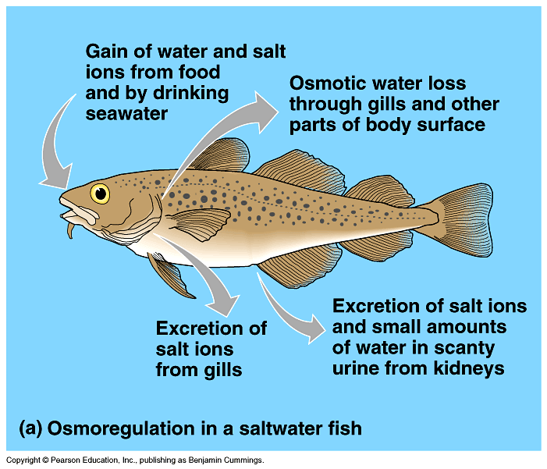
Osmoregulation in Saltwater Fish
Marine fish face two problems: they tend to lose water and gain ions.

Slide 4
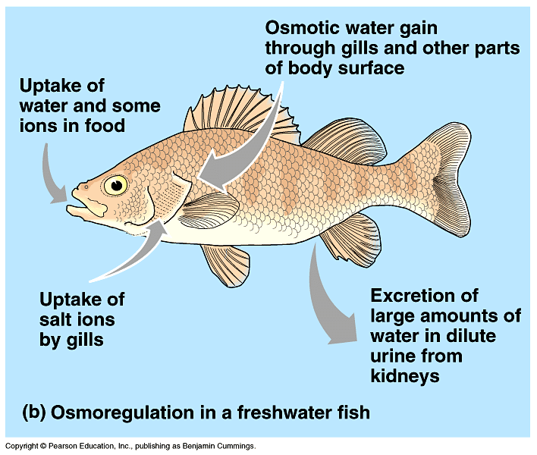
Osmoregulation in Freshwater Fish
Freshwater fish face two problems: they tend to lose ions and gain water.

Slide 5
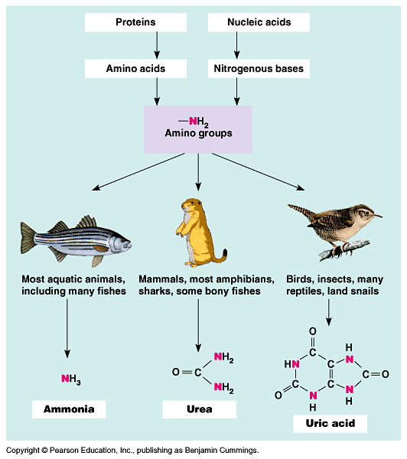
Nitrogenous Wastes
Ammonia
Urea
Uric acid

Slide 6
What about rapid ion flux?
Euryhaline
Short-term fluctuations in osmotic state of environment, e.g. in intertidal zone or in estuaries
salinity can range from 10 to 34 ppt with daily tides
these fish have both kinds of chloride cells
when salinity is low, operate more like FW fishes
when salinity is high, operate like marine fishes
kidneys function only under low salinity conditions
Notes:
Euryhaline organisms are able to adapt to a wide range of salinities. An example of a euryhaline fish is the molly (Poecilia sphenops) which can live in fresh, brackish, or salt water. The European shore crab (Carcinus maenas) is an example of a euryhaline invertebrate that can live in salt and brackish water. Euryhaline organisms are commonly found in habitats such as estuaries and tide pools where the salinity changes regularly. However, some organisms are euryhaline because their life cycle involves migration between freshwater and marine environments, as is the case with salmon and eels

Slide 7
Euryhalinity & Adaptation
Euryhaline organisms are able to adapt to a wide range of salinities. An example of a euryhaline fish is the molly (Poecilia sphenops) which can live in fresh, brackish, or salt water. The European shore crab (Carcinus maenas) is an example of a euryhaline invertebrate that can live in salt and brackish water. Euryhaline organisms are commonly found in habitats such as estuaries and tide pools where the salinity changes regularly. However, some organisms are euryhaline because their life cycle involves migration between freshwater and marine environments, as is the case with salmon and eels.

Slide 8
How to reduce stress in stressed fish?
Minimize the osmotic challenge by placing fish in conditions that are isosmotic
add salt to freshwater, e.g. in transporting fish or when exposing them to some other short-term challenge
dilute saltwater for same situation with marine species
Notes:
Stressors (handling, sustained exercise such as escape from predator pursuit) cause release of adrenaline (epinephrine)
Adrenaline causes diffusivity of gill epithelium to increase (become “leaky” of water & ions)
This accentuates the normal osmoregulatory challenge for FW or marine fishes

Slide 9
Challenging Osmotic Stress
Stressors (handling, sustained exercise such as escape from predator pursuit) cause release of adrenaline (epinephrine)
Adrenaline causes diffusivity of gill epithelium to increase (become “leaky” of water & ions)
This accentuates the normal osmoregulatory challenge for FW or marine fishes

Slide 10
Osmoregulation Strategies
Osmoconforming (no strategy) Hagfish internal salt concentration = seawater. However, since they live IN the ocean....no regulation required!

Slide 11
Osmoregulation Strategies
Elasmobranchs (sharks, skates, rays, chimeras)
Maintain internal salt concentration ~ 1/3 seawater, make up the rest of internal salts by retaining high concentrations of urea & trimethylamine oxide (TMAO).
Bottom line…total internal osmotic concentration equal to seawater!
How is urea retained?
Gill membrane has low permeability to urea so it is retained within the fish. Because internal inorganic and organic salt concentrations mimic that of their environment, passive water influx or efflux is minimized.

Slide 12
Osmotic regulation by marine teleosts...
ionic conc. Approx. 1/3 of seawater
drink copiously to gain water
Chloride cells eliminate Na⁺ and Cl⁻
kidneys eliminate Mg⁺⁺ and SO₄⁼
advantages and disadvantages?

Slide 13
Saltwater teleosts:
active tran.
passive diff.
H₂O
drink
Na⁺, Cl⁻
Na⁺, Cl⁻
Mg⁺⁺, SO₄⁼
Na⁺, Cl⁻
Mg⁺⁺, SO₄⁼
chloride cells
kidneys

Slide 14
CHLORIDE CELLS
Chloride cells are cells in the gills of teleost fishes which pump excessive sodium and chloride ions out into the sea against a concentration gradient (Active transport). Energy cost ?

Slide 15
Mechanism of action
Teleost fishes consume large quantities of seawater to reduce osmotic dehydration. The excess of ions absorbed from seawater is pumped out of the teleost fishes via the chloride cells. These cells use active transport on the basolateral (internal) surface to accumulate chloride, which then diffuses out of the apical (external) surface and into the surrounding environment. Such mitochondria-rich cells (?) are found in both the gill lamellae and filaments of teleost fish.

Slide 16
active
Chloride Cell
passive
sea water
PC
pavement
cell
Cl⁻
Na⁺
accessory
cell
PC
Cl⁻
Cl⁻
Na⁺
Na⁺
+
Na⁺, Cl⁻
Na⁺
Na⁺
carrier
pump
K⁺
Na⁺ K⁺ ATPase
gut
Cl⁻
chloride cell
mitochondria
internal
tubular system

Slide 17
Osmotic regulation by FW teleosts
Ionic conc. Approx. 1/3 of seawater
Don’t drink
Chloride cells fewer, work in reverse
Kidneys eliminate excess water; ion loss
Ammonia & bicarbonate ion exchange mechanisms
advantages and disadvantages?

Slide 18
Freshwater teleosts
active
passive
H₂O
don’t
drink
Na⁺, Cl⁻
Na⁺, Cl⁻
water
Ion exchange
pumps; beta chloride cells
kidneys

Slide 19
Ion Exchange Mechanisms
freshwater
interior
Na⁺
active
pump
ATP
NH₄⁺ or H⁺
Cl⁻
active
pump
ATP
HCO₃⁻
gill membrane

Slide 20
Conclusive discussion
Energy cost of osmoregulation in marine, brackish water and freshwater fishes.
Endocrine (hormone) control of osmoregulation.
The role of kidney and rectal gland in salt balance in elasmobranchs.
Diet and osmoregulation.
Interactions of immune and osmoregulatory systems.

